Slide 1
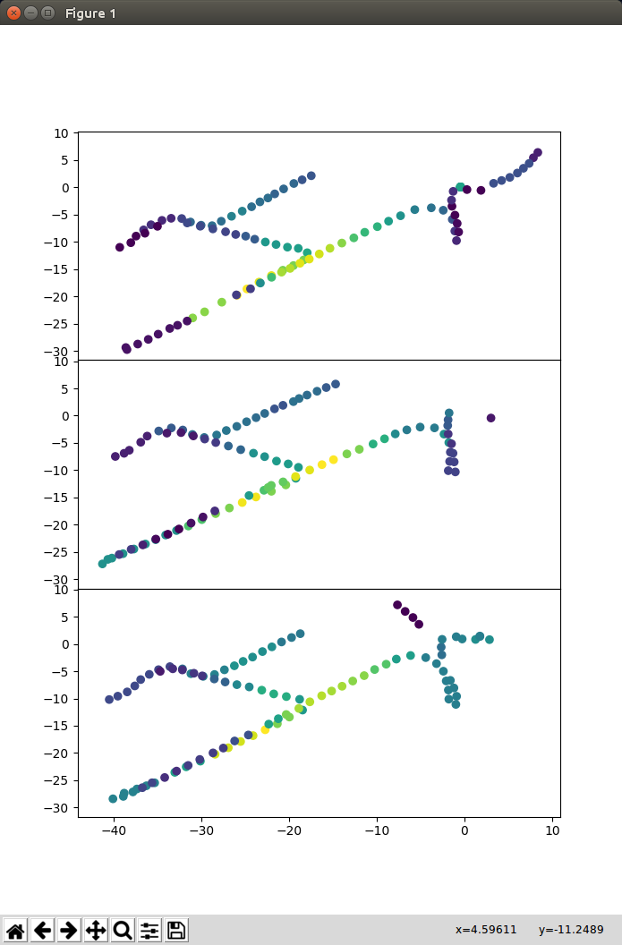
Yellowish → High Signal Strength (Closer to AP)
Dark Purplish → Weak Signal Strength (Further to AP)
MAC Address : 18:64:72:56:26:d4
Scatter plot using matplotlib
Pose values and RSSI values filtered by MAC Address

Slide 2
